Slide 2
Min 15-30: Moodle Quiz (5 questions, 15 min)
Learning Objectives (Géron Ch10 & Ch11):
Define an artificial neural network
Understand activation functions
Understand the steps & best practices to build an artificial neural network
Know the main hyperparameters defining a neural network’s architecture
Know the main hyperparameters controlling the training of an NN
Notes:
Questions?
Not graded

Slide 3
Min 30-60: Deep Learning to Emulate the Components of Earth System Models
Re-read the article and write down (1) the scientific goal of the paper; (2) One simple question with your neighbor. Example: How did the authors choose their best neural network architecture?

Slide 4
In a climate model, can we replace an expensive model of storms with a NN?
Problem: - The full-complexity storm-resolving models are too expensive to run
- Current climate models forced to rely on empirical models of clouds

Slide 5
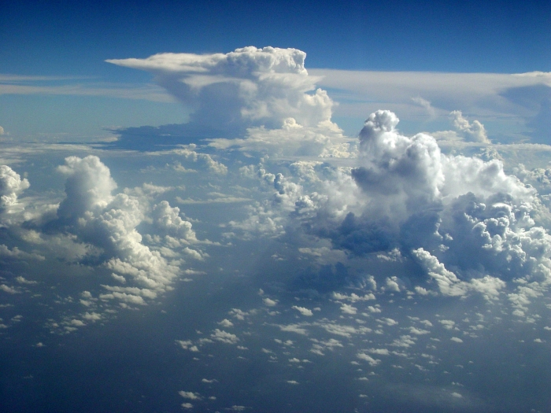
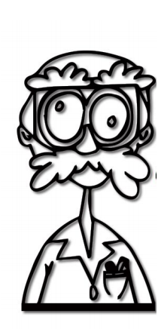
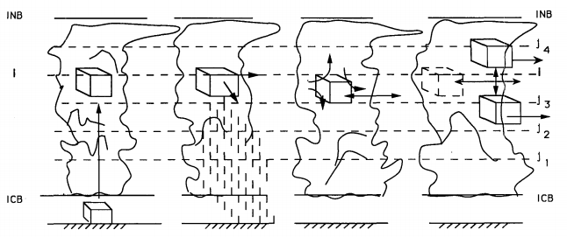
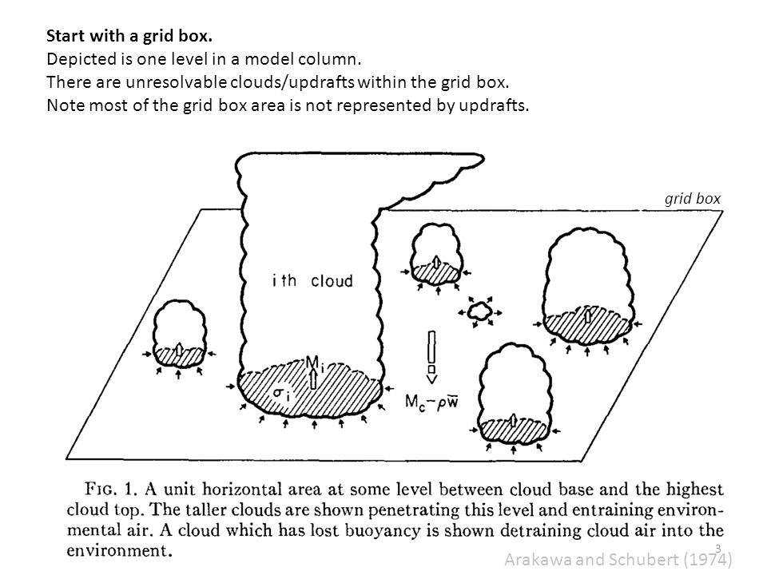
100 km
Problem: - The full-complexity storm-resolving models are too expensive to run
- Current climate models forced to rely on empirical models of clouds
Idea: Train an artificial neural network from high-resolution simulation data Result: Neural networks can accurately emulate effects of storms on climate
Source: C. Bretherton, S. Rasp, Arakawa and Schubert, Emanuel

Slide 6
Atmospheric Convection = Atmospheric motion driven by air density differences
Notes:
Atmospheric convection is the atmospheric motion driven by air density differences, often from the sun heating the surface resulting in less dense air that then ascends, which is exactly what is happening in this storm during the North American Monsoon. As convection form clouds that interact with radiation [BREAK] and interact with storms that transport heat, water, and tracers such as dust, atmospheric convection is responsible for fast vertical energy transfer between the surface, the atmosphere and space.

Slide 7
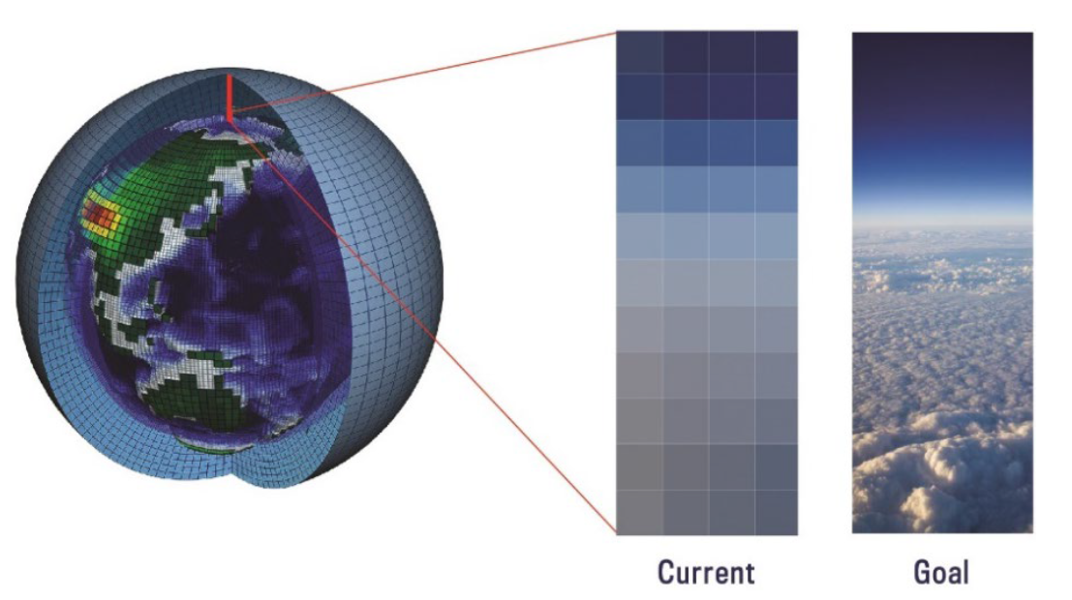
Motivation 1: Largest uncertainties in climate projections from clouds
Source: Zelinka et al. (2020), Meehl et al. (In Review), Gentine, Eyring & Beucler (2020)
Notes:
Because of their major importance for vertical energy transfer, we would like to resolve the effect of convection and clouds on the climate in our models because they are a major constraint on climate sensitivity. Unfortunately, models fail at representing these effects because most climate models use a coarse-grid with empirical models of clouds, which distorts the multi-scale interaction between climate, convection, and clouds. This leads to large uncertainties and explain why for a given emission scenario, the representation of clouds remain the primary source of uncertainty in our long-term climate projections, which is the first motivation for this talk.

Slide 8
Motivation 1: Largest uncertainties in climate projections from clouds
Motivation 2: Global cloud-resolving models can resolve convection & clouds at $\sim$1km, but only for short period (1 year)
Source: Stevens et al. (2019), Sato et al. (2009), SAM: Khairoutdinov and Randall (2003), Lee and Khairoutdinov (2015)
Notes:
The second motivation is that thanks to computational advances, we are now able to run global simulations with a grid fine enough to explicitly simulate deep cloud systems. However, because of computational limits, we are only able to run such simulations for a short period of time, for instance 1 year, which pales in contrast to the hundred year simulations we need for long-term climate predictions.

Slide 9
Motivation 1: Largest uncertainties in climate projections from clouds
Motivation 2: Global cloud-resolving models can resolve convection & clouds at $\sim$1km, but only for short period (1 year)
Motivation 3: ML can accurately mimic $\sim$1km convective processes
See: Rasp et al. (2018), Brenowitz et al. (2018,2019), Gentine et al. (2018), Yuval et al. (2020), Krasnopolsky et al. (2013)
Notes:
In parallel to the development of global cloud-resolving models, progress in stochastic optimization & computational capabilities has improved machine learning algorithms- And in this talk, ML generally describes algorithms that learn to perform a task from data without being explicitly programmed for that task. So recent computational progress has *improved* ML algorithms to the point where they can be trained on these high-resolution simulations to accurately mimic the effect of deep cloud systems on climate. This requires a bit of context [switch]

Slide 10
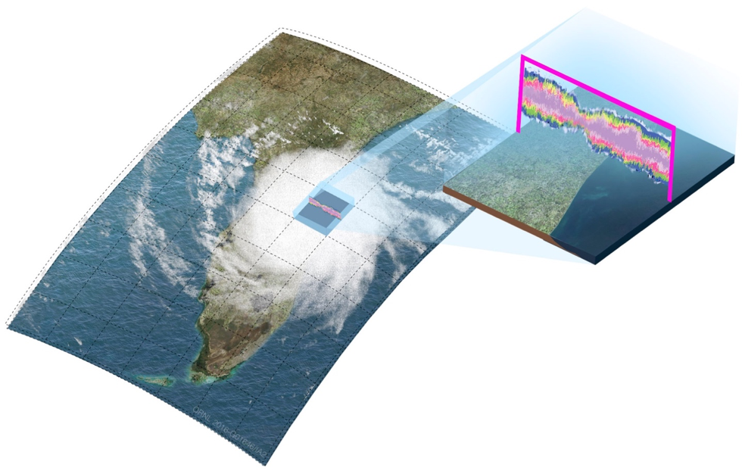
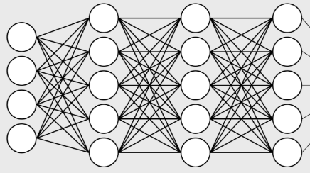
ML of Subgrid-Scale Thermodynamics
Neural Network:
20 times faster
Setup : Super-Parameterized climate model, Aquaplanet & Earth-like
Year 1 for training (≈50M samples), Year 2 for validation/test
Image source: e3sm.org, Model source: Khairoutdinov et al. (2004)
Notes:
In my research, I mostly rely on climate simulations that use the super-parametrized community atmospheric model, where the multi-scale nature of atmospheric thermodynamics is explicitly represented via the combination of (on the left) an exterior model almost identical to a traditional global climate model, and (on the right) an interior model, which is an expensive cloud-resolving model explicitly representing the response of convection and fine-scale turbulence to given large-scale thermodynamic conditions. The role of the neural network is to emulate and replace the interior model, which can make the climate model up to a hundred times faster with minimal accuracy trade-off.

Slide 11
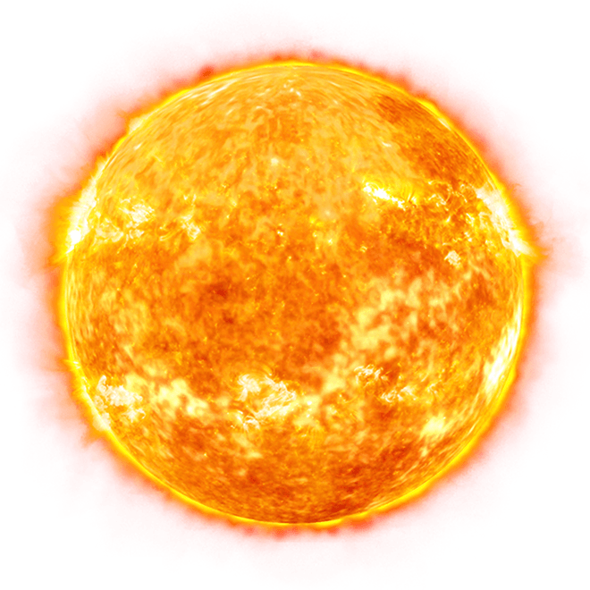
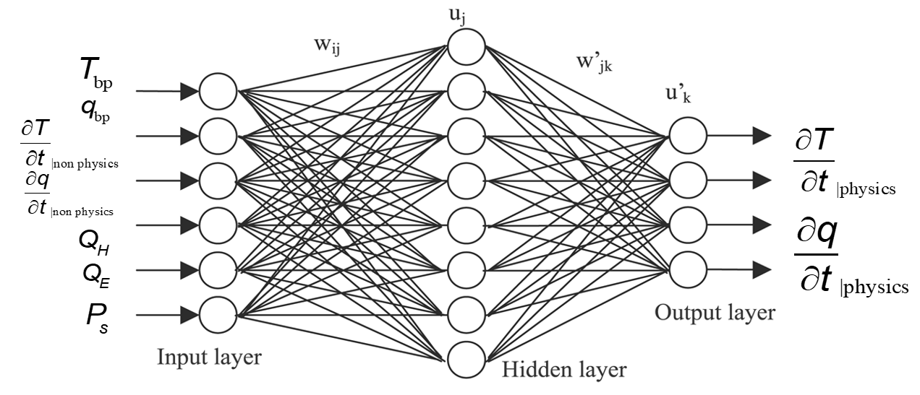
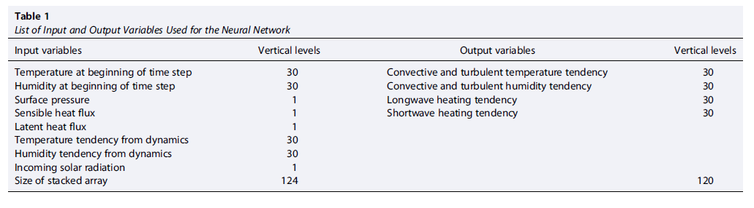

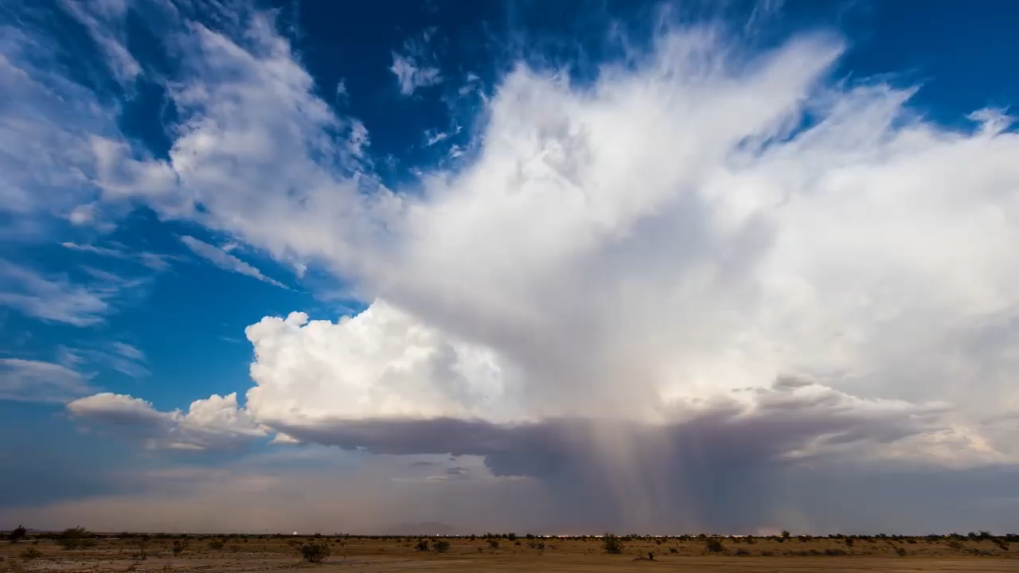
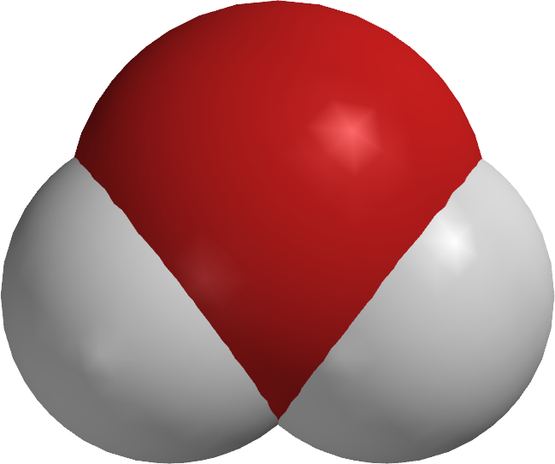

Radiative Fluxes
Insolation
Temperature
Subgrid
Heating
Specific
Humidity
Subgrid
Moistening
Surface Enthalpy Fluxes
Notes:
In our case, the details of the neural network can be adjusted for the modeling task at hand, but all the neural networks (define) I will present today take insolation, temperature, and specific humidity or water vapor concentration, and surface enthalpy fluxes as inputs. They then output subgrid-scale thermodynamics fluxes, which is how unresolved clouds and turbulence redistribute heat and water vapor in the vertical, as well as radiative fluxes at the surface and the top of the atmosphere.

Slide 12
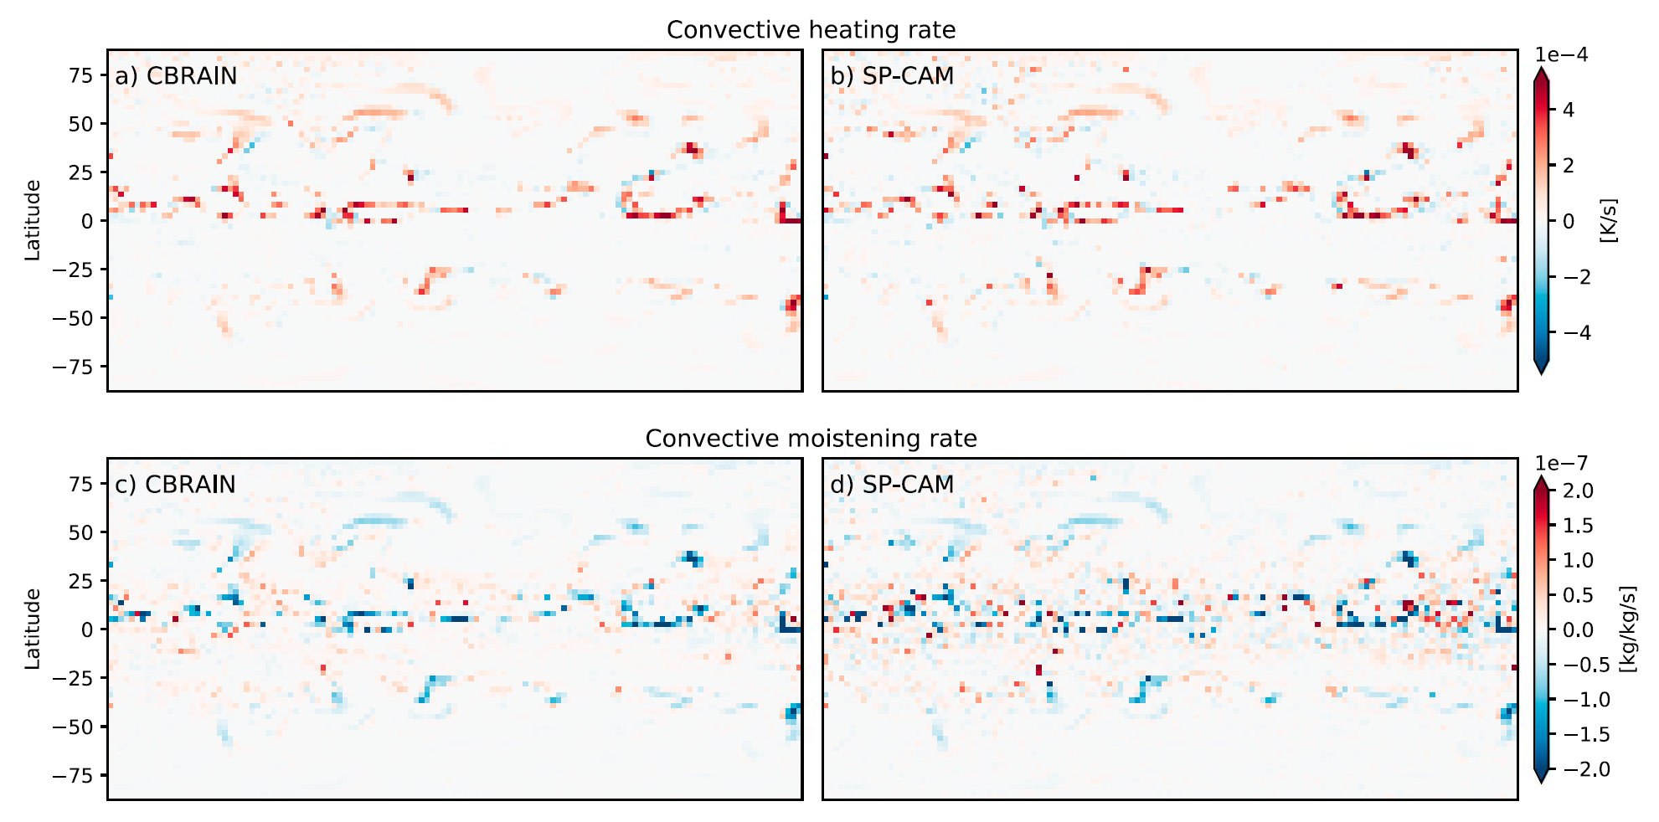
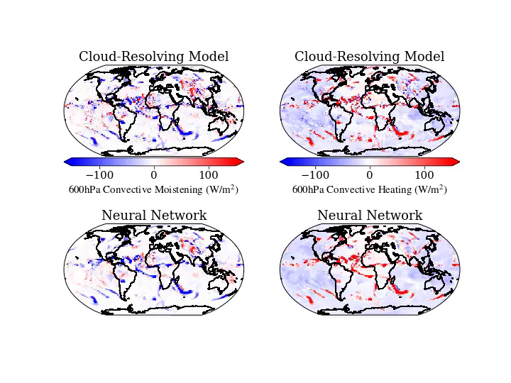
Truth
Super-param.
simulation
Prediction
NN
(offline)
Source: Mooers, Pritchard, Beucler et al. (2021)
See: Rasp et al. (2018), Brenowitz et al. (2018,2019), Gentine et al. (2018), Yuval et al. (2020), Krasnopolsky et al. (2013)
Notes:
Here is a movie showing the performance of such a NN at emulating subgrid-scale thermodynamics from a super-parametrized climate simulation with Earth-like boundary conditions, with the ground truth we are trying to emulate at the top, the NN prediction at the bottom, convective moistening on the left and convective heating on the right. We can see that it does extremely well given the complexity of the task at hand.
3 problems

Slide 13
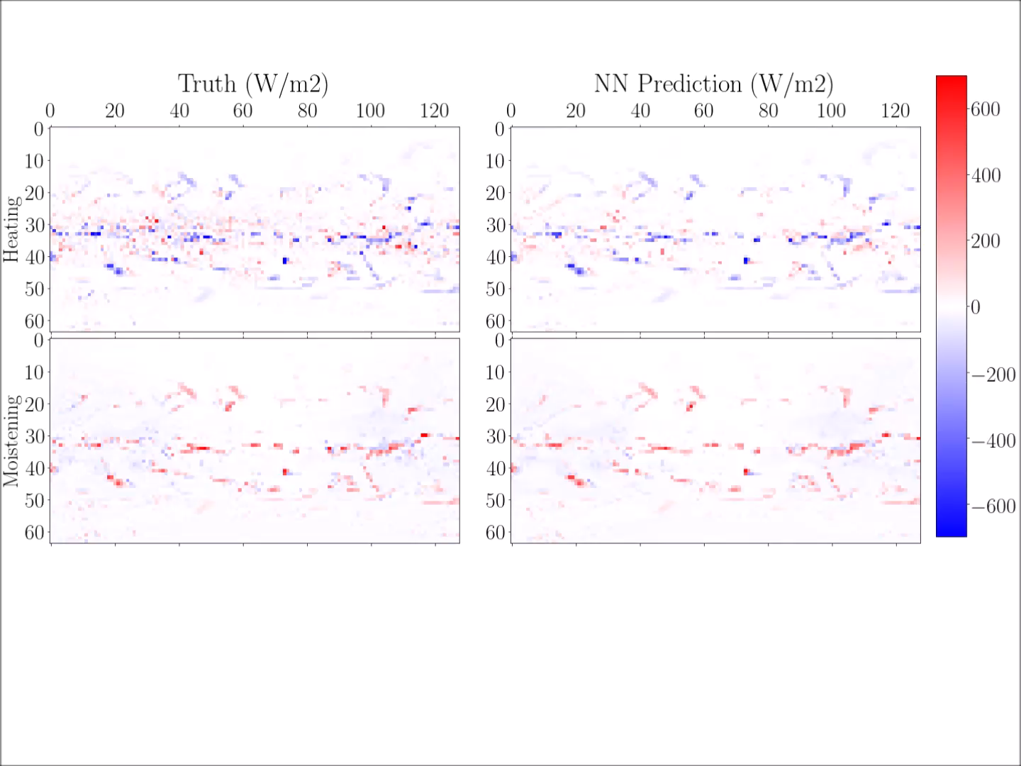

Slide 14
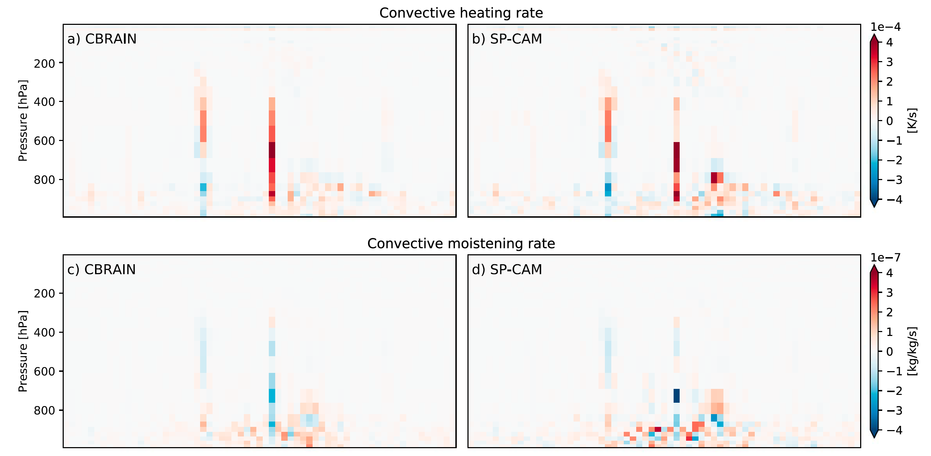
See: Rasp et al. (2018), Brenowitz et al. (2018,2019), Gentine et al. (2018), Yuval et al. (2020), Krasnopolsky et al. (2013)
Notes:
Here is a movie showing the performance of such a NN at emulating subgrid-scale thermodynamics from a super-parametrized climate simulation with Earth-like boundary conditions, with the ground truth we are trying to emulate at the top, the NN prediction at the bottom, convective moistening on the left and convective heating on the right. We can see that it does extremely well given the complexity of the task at hand.
3 problems

Slide 15
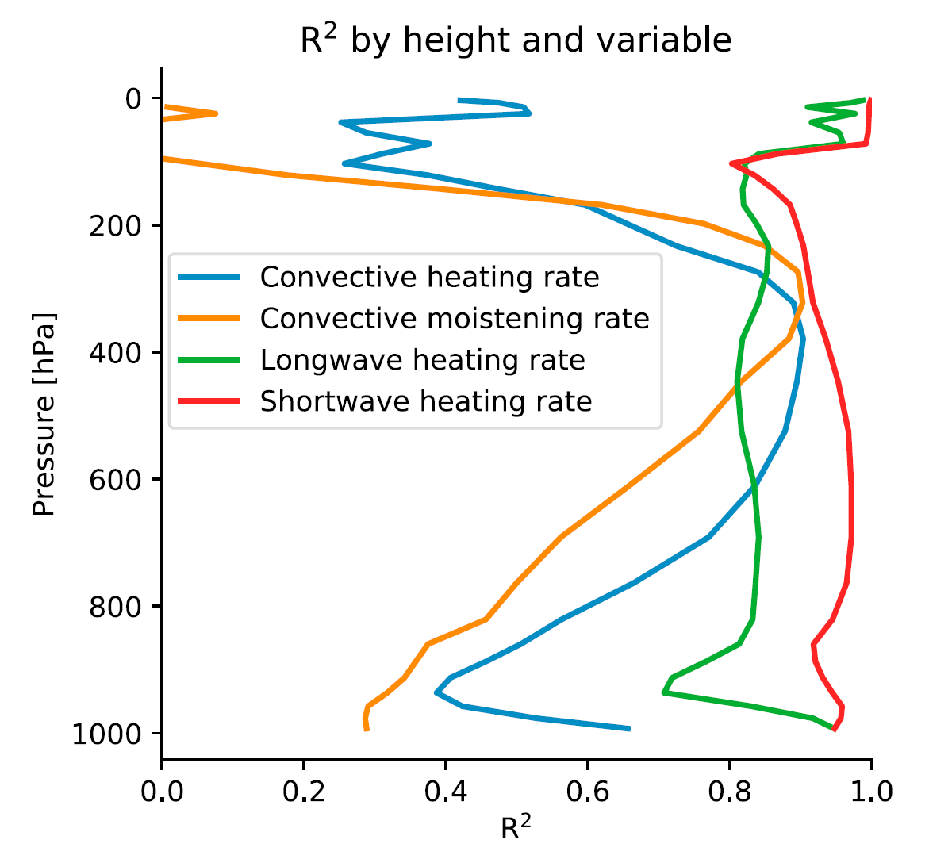
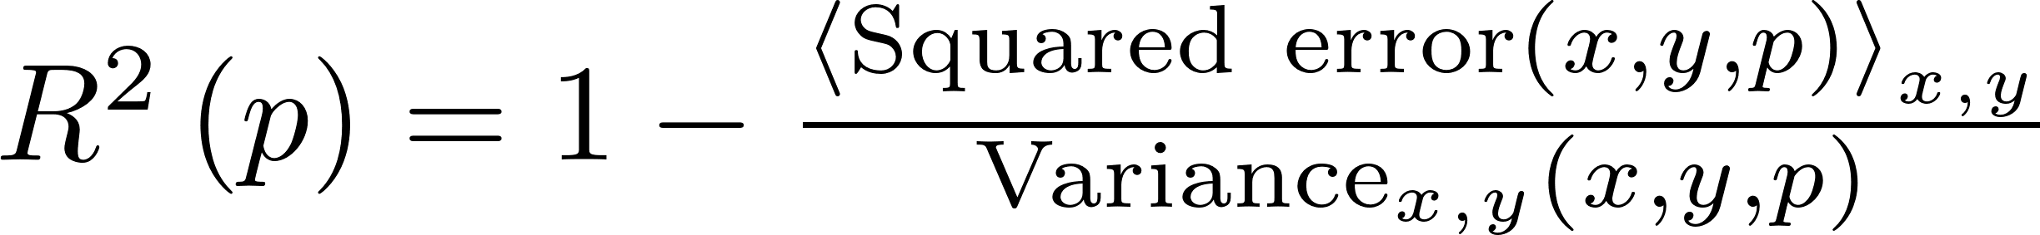
Coefficient of Determination
≠
Coefficient of Correlation

Slide 16
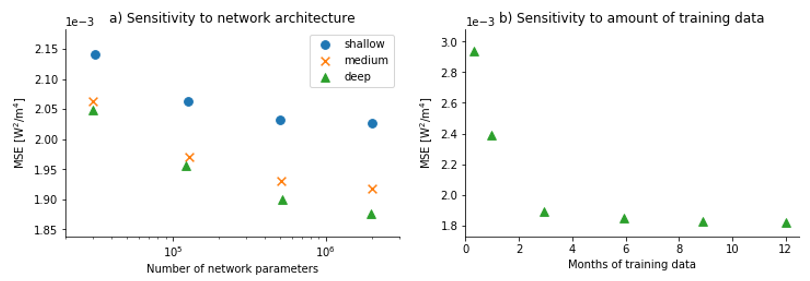
How did the authors choose their architecture?
Deeper and Wide neural networks are more accurate (universal approx. theorem)
More data helps, but 4 months is enough

Slide 17
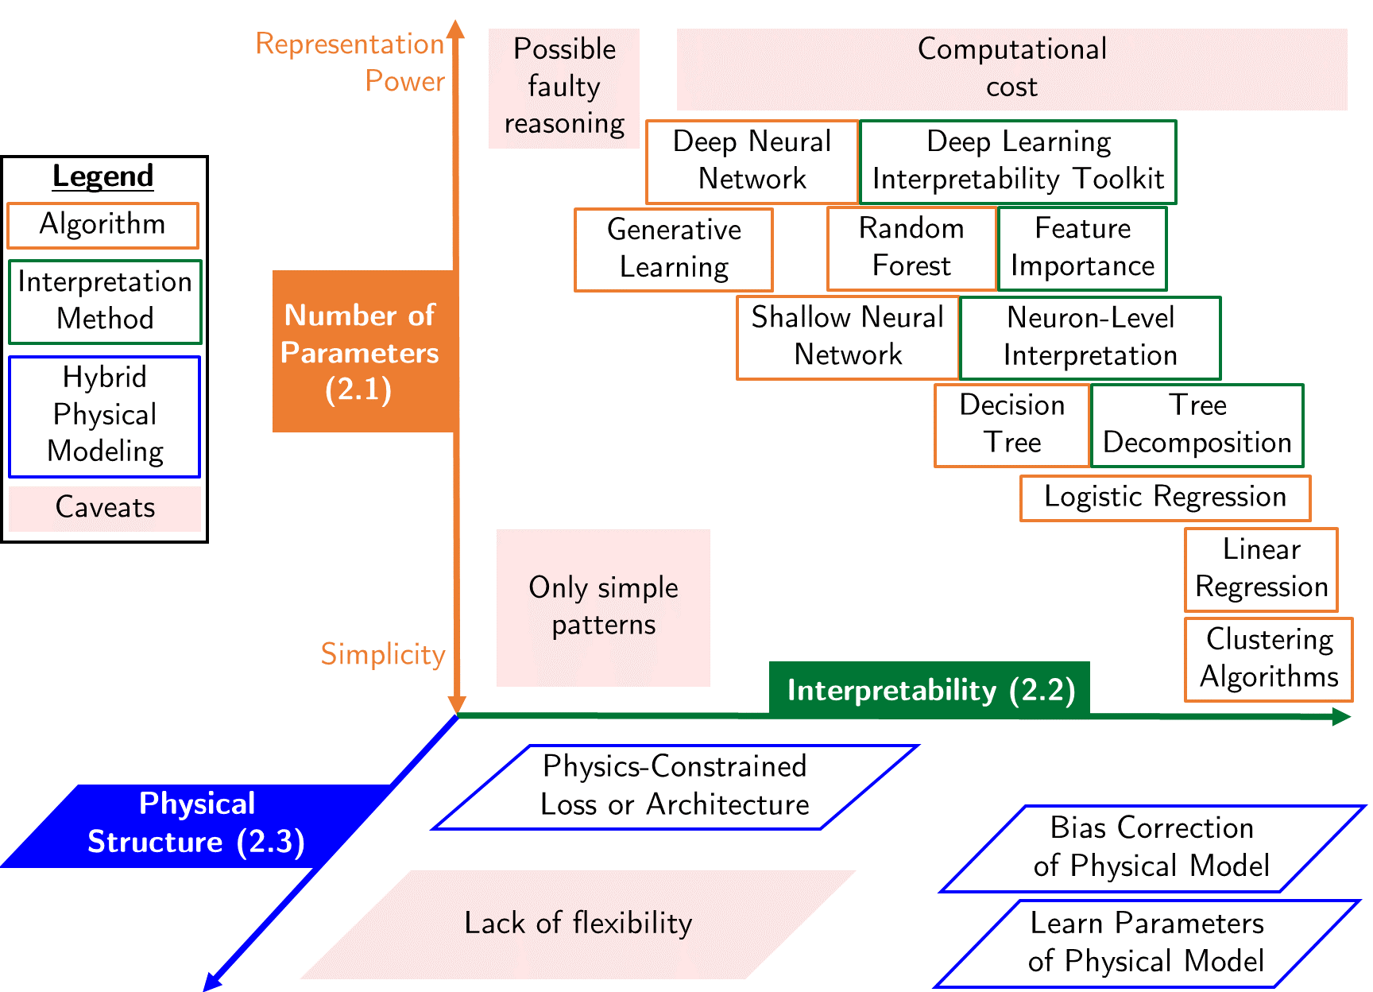
Source: Beucler et al. (2021)

Slide 18
Now let’s go back to the initial questions

Slide 19
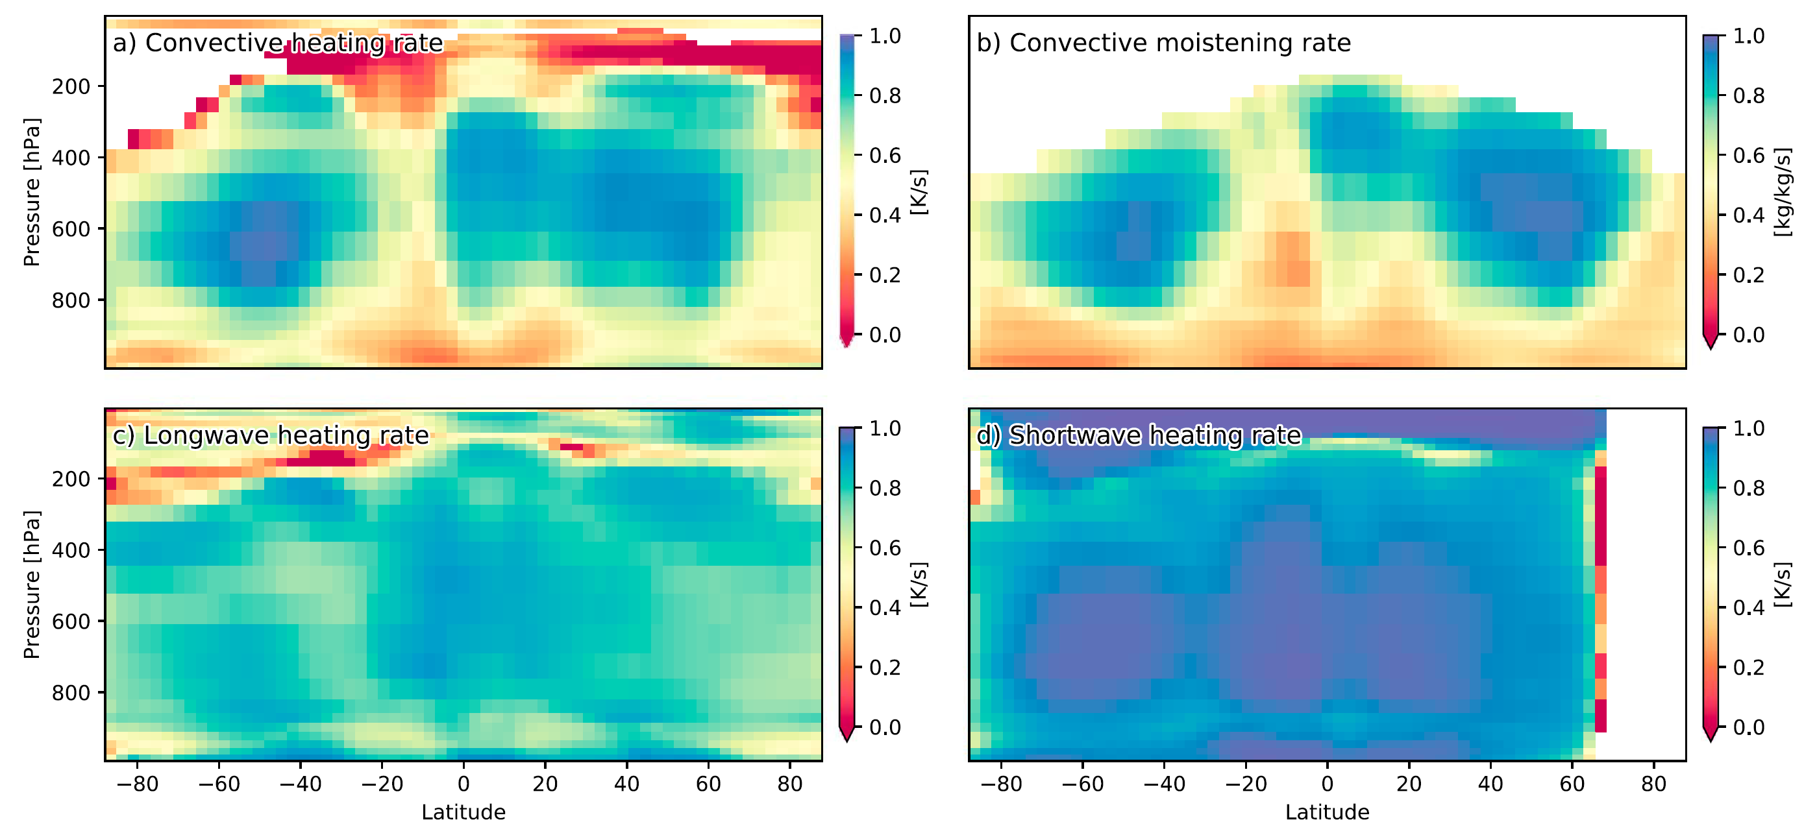

Slide 20
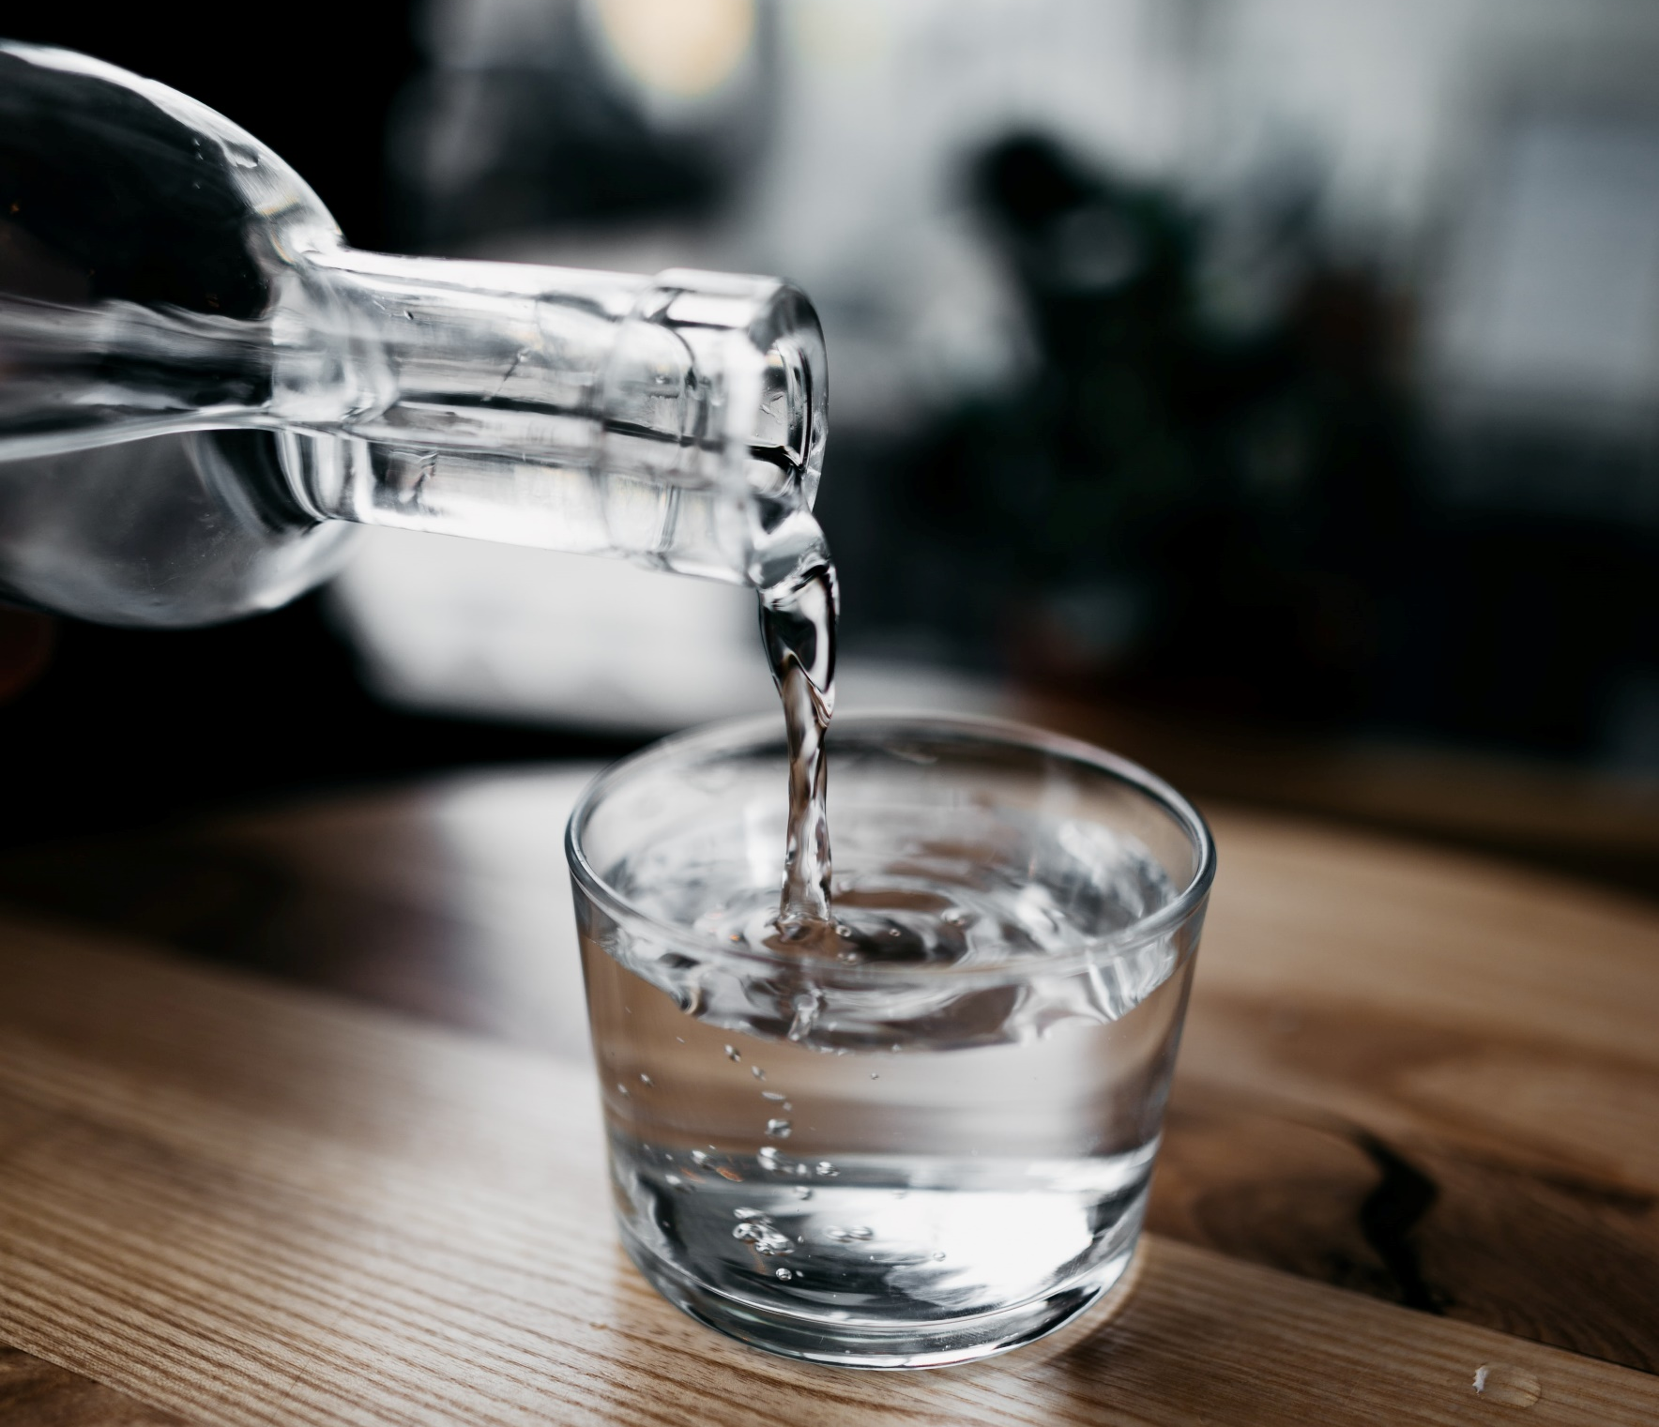
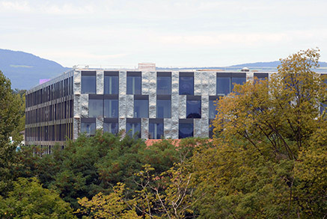
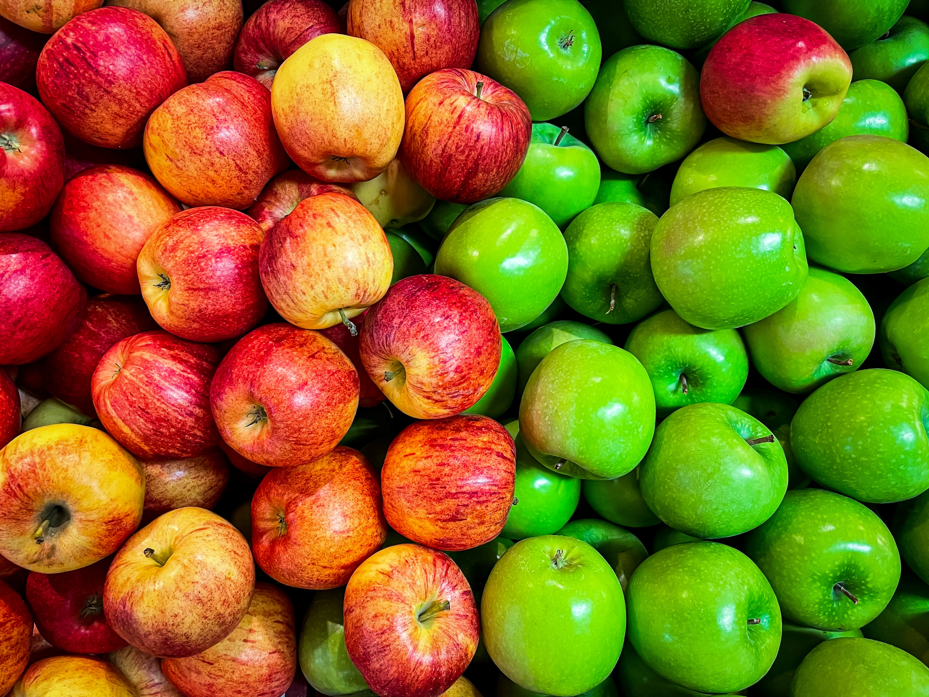
Min 60-75: Break

Slide 21


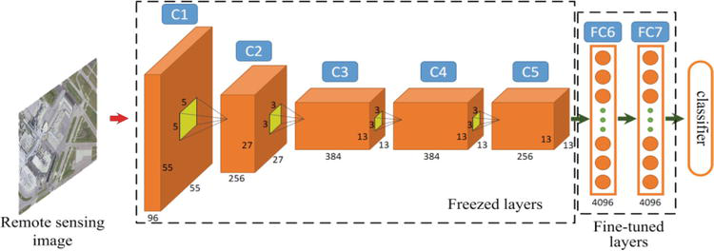
ML for Earth & Env Sci (Week 5, SP2022)
How can we extract information from images/videos using deep learning?
Source: Luo et al. (2018)
Notes:
COSERO hydrological model

Slide 22
Mid-term Presentations Friday, Nov 17th in Geopolis 2138 (10AM-Noon)
4min presentations + 6min Q&A/feedback
Tip = 1 slide/minute
Scientific question: What’s our goal and why do we care?
Dataset: Characteristics, challenges, training/validation/test split, etc.
Methodology: Which ML algorithm(s) are you planning to use and why?
Results: What are your initial results & what do you plan to do next?

Slide 23

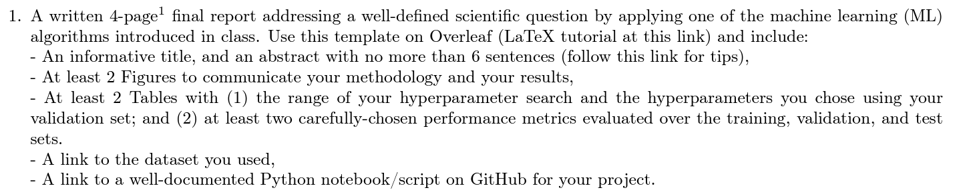
In-class Peer Review: Friday, Dec 8th, 2PM-4PM
Submit first draft of your project by Thursday, Dec 7th

Slide 24
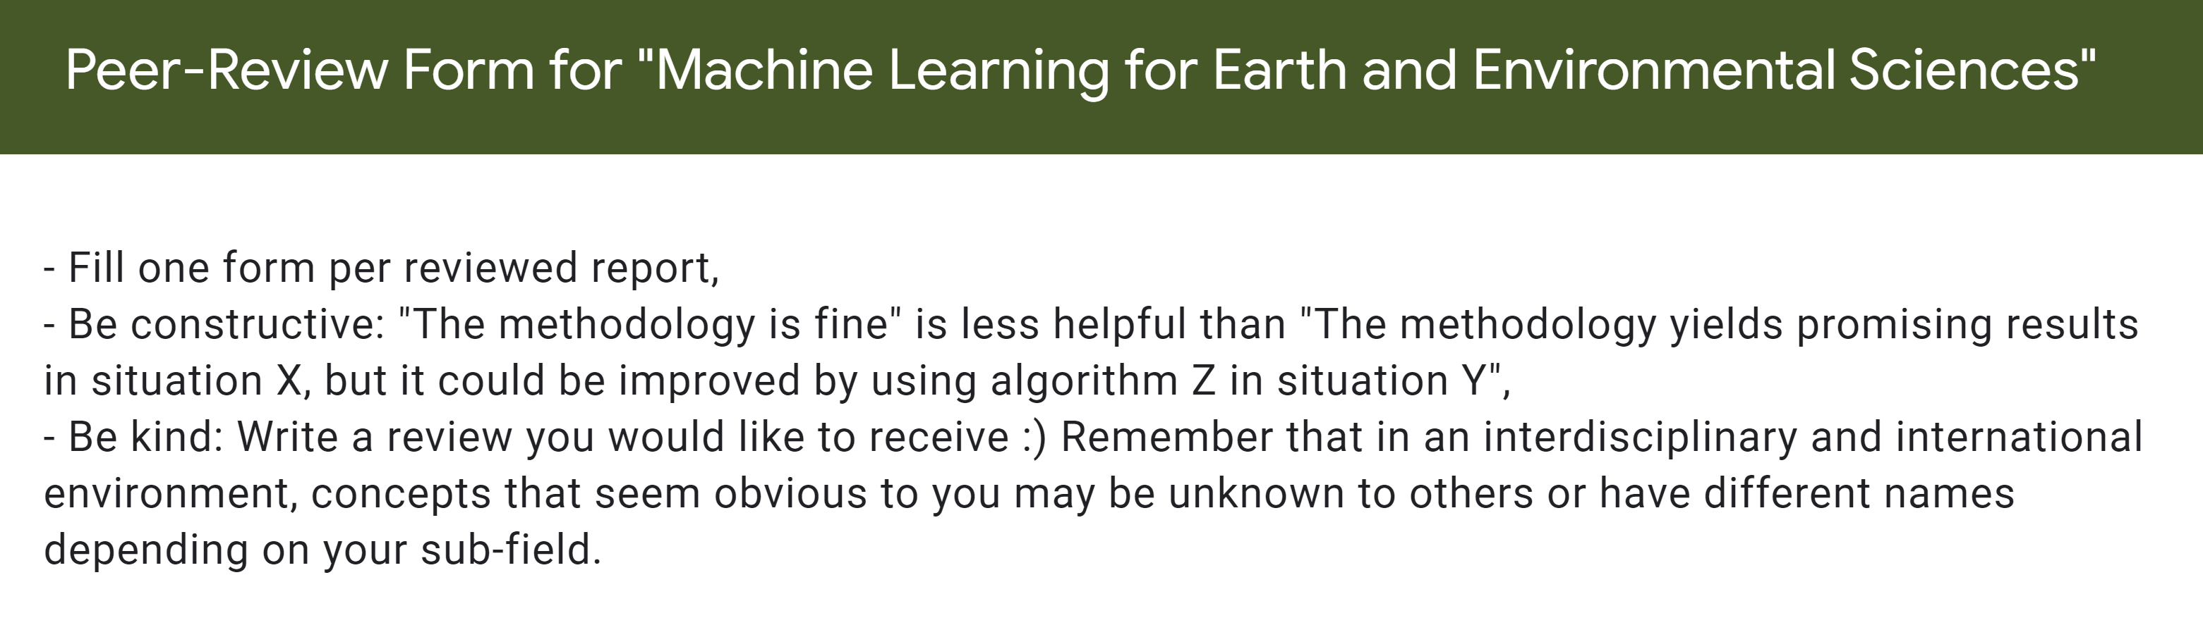
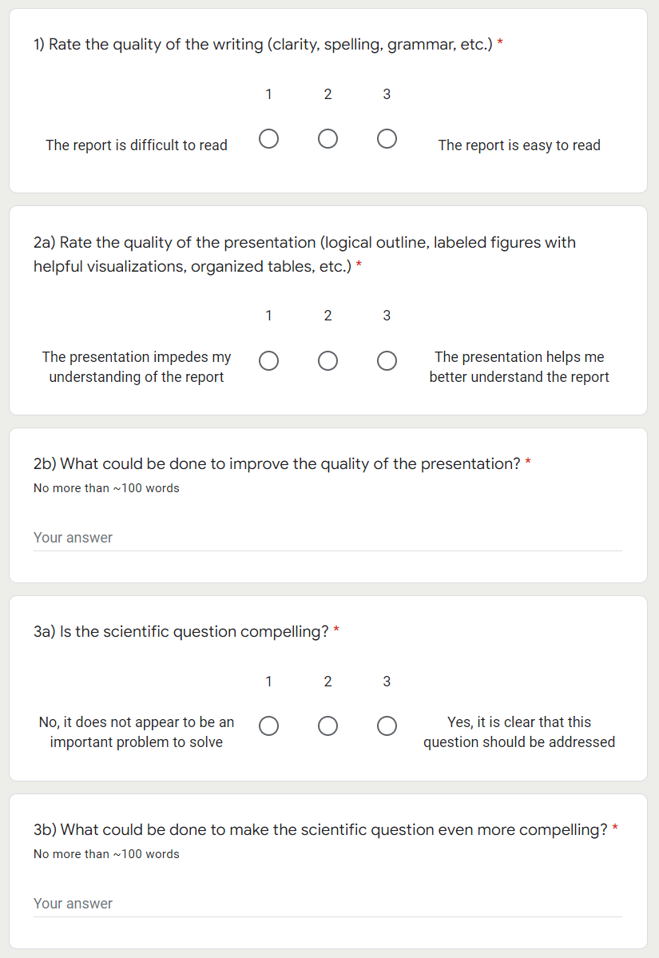
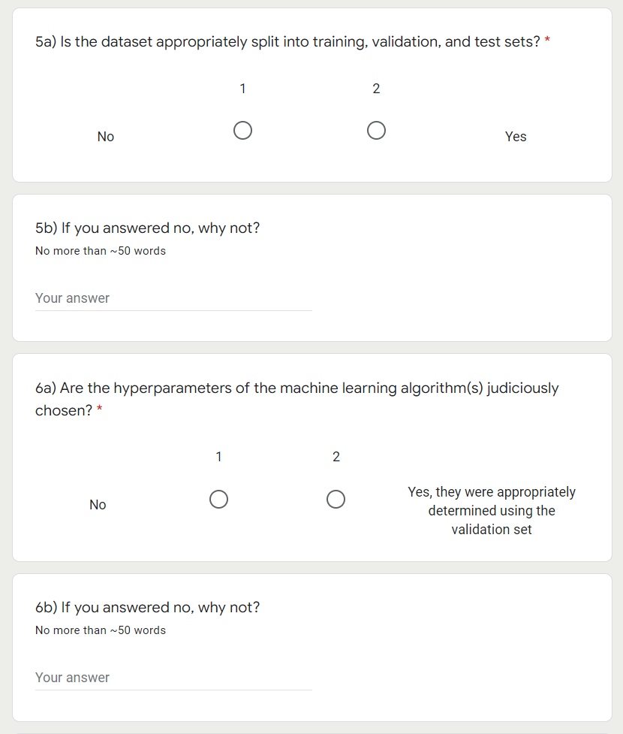

Slide 25
Final Presentations in room 2138 Friday, Dec 15th from 2PM to 4PM
4min presentations + 1min Q&A
Tip = 1 slide/minute
Scientific question: What’s our goal and why do we care?
Dataset: Characteristics, challenges, training/validation/test split, etc.
Methodology: Which ML algorithm(s) did you choose and why?
Results: What are your findings and how does it answer the sci. question?

Slide 26

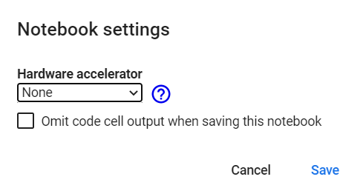

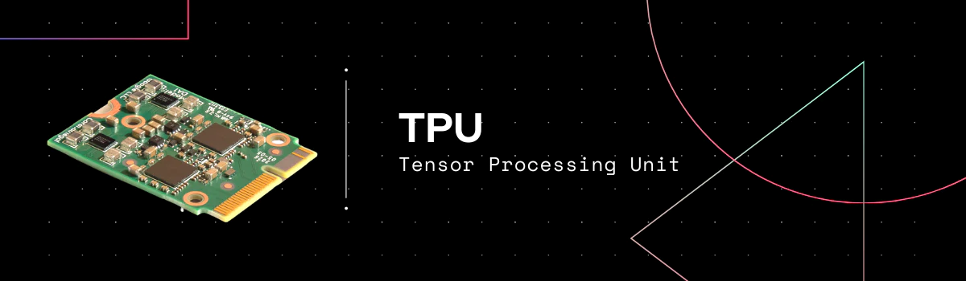
Has several cores but very precise
Executes instructions serially
Good for large models (large RAM), small batch sizes, custom calcs.
Has thousands of cores
Specialized for parallel processing
Good for larger batch sizes and deep learning in general
Specialized for matrix processing
Good for large batch sizes & CNN
(Edit menu)
Source: https://premioinc.com/blogs/blog/what-is-the-difference-between-cpu-vs-gpu-vs-tpu-complete-overview
Notes:
We talked about computational time, let’s briefly introduce hardware

Slide 27
Min 80-105: Convolutional Neural Networks to Process Images
Learning Objectives (Géron Ch14):
Define a convolutional neural network
Discuss the main applications of convolutional neural networks
Know the steps to design and train a convolutional neural network
Define transfer learning and understand how to re-use pre-trained models

Slide 28
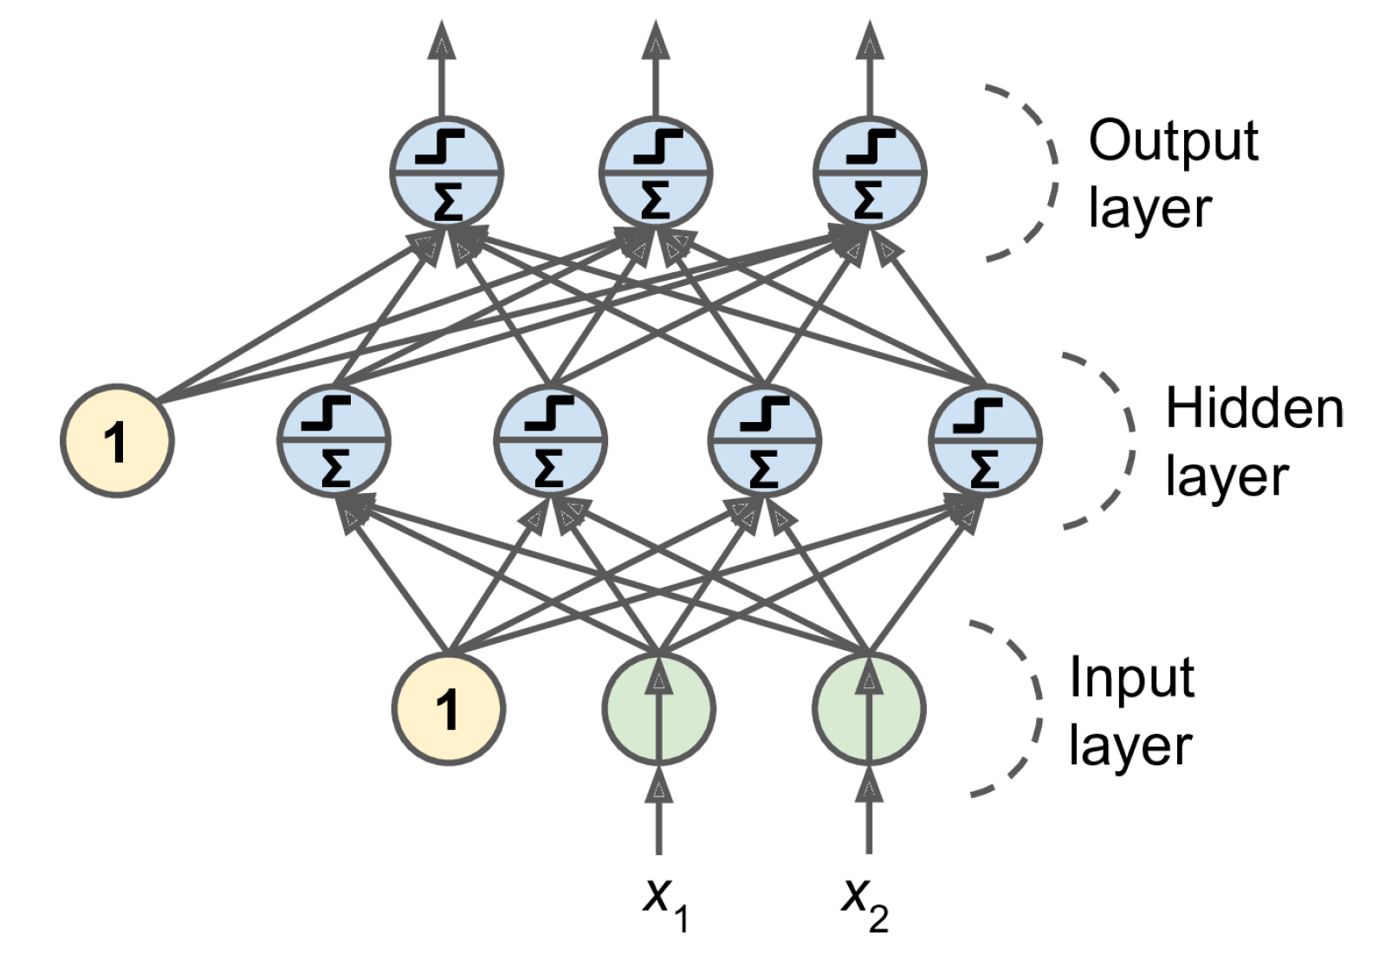
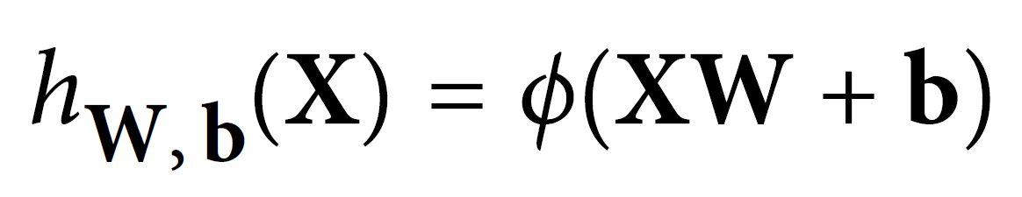
Last week = general case: Artificial Neural Networks
Notes:
1 layer = similar to logistic regression
2 layers = shallow neural network
Deep learning = 3 layers and above
VOTE 1: How many trainable parameters (weights and biases) in the input layer?
VOTE 2: If the input layer was a 10x10 image, how many trainable parameters?

Slide 29


This week: Convolutional Neural Networks (CNNs)
Regularized versions of Artificial Neural Networks used to process images
Source: Giphy, Analytics India Magazine (K. Maladkar)

Slide 30
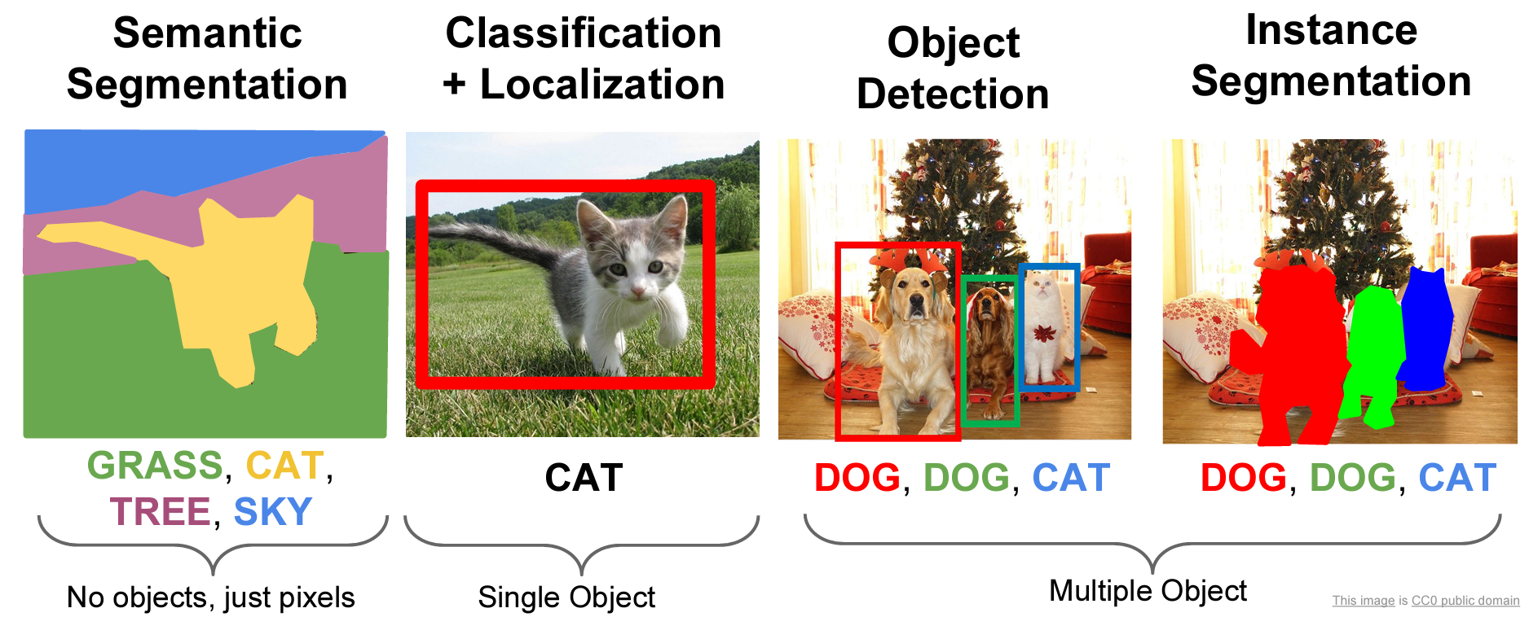
CNNs used for computer vision (analyzing images, videos)
Source: Stanford (CS231)

Slide 31
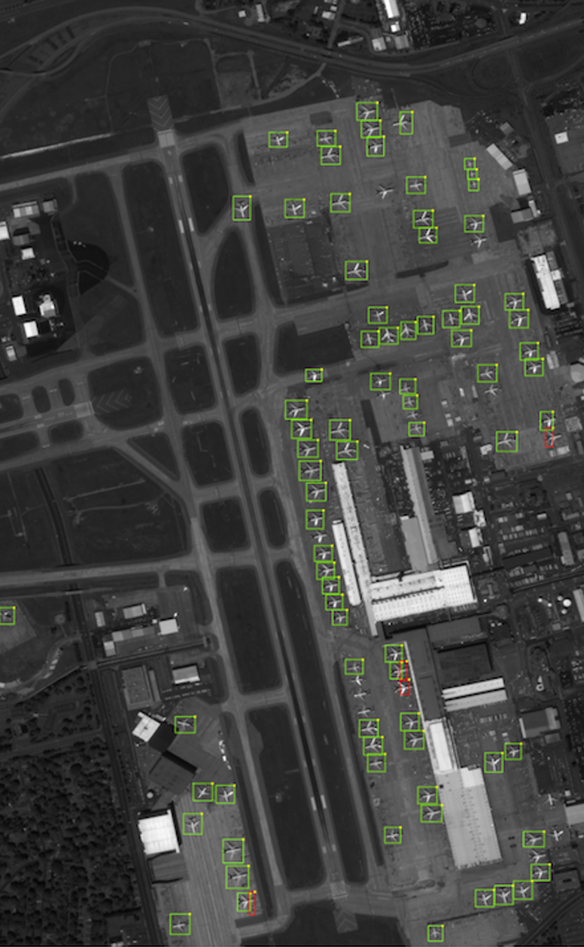
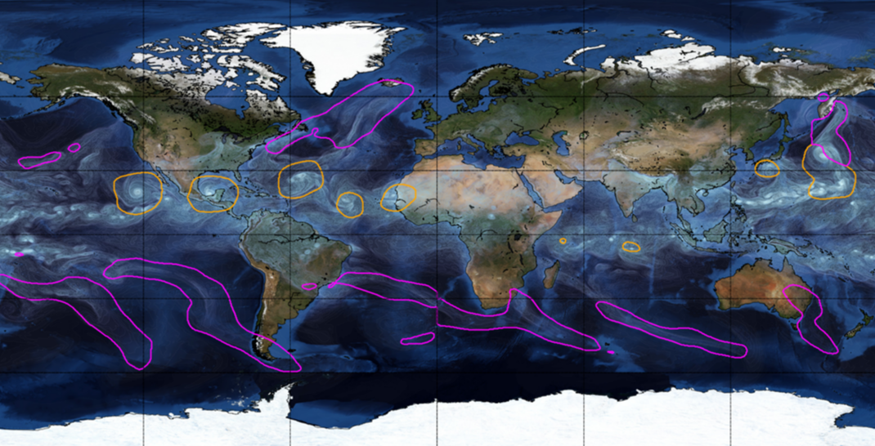
Object Detection for Remote Sensing
Instance Segmentation for Storm Detection
Source: Zhu et al. (2017), Prabhat et al. (2020)
Notes:
VOTE: Which output contains the most information?

Slide 32
Environmental Applications
Object Detection
Semantic Segmentation
catchment was flooded
classify parts of a catchment as being flooded or not.
In forestry, it could be classifying a remote sensing image into forest and non-forest
identifying every single tree in an image
"draw" the boundary of each rock glacier, individually
you will know for each pixel if this pixel "is in" a rock glacier, but you will not be able to know how many there is, just where there are rock glaciers on the picture

Slide 33
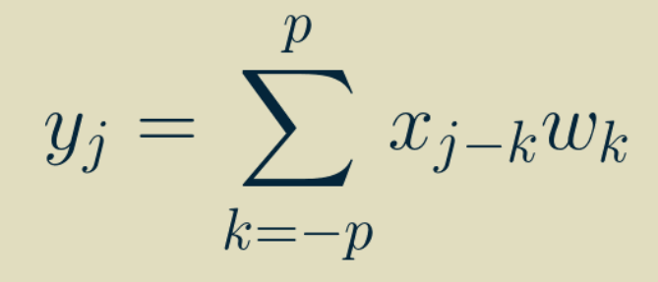
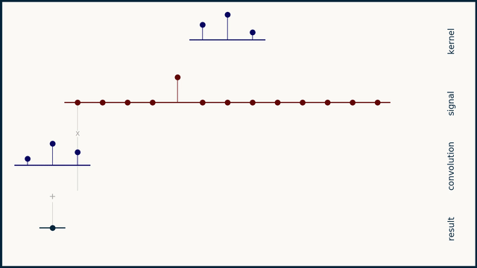
One-dimensional Convolution
Output
Input
Weights
Simple & inexpensive
Source: Brandon Rohrer
Notes:
VOTE: How many trainable parameters (weights and biases) for this operation?

Slide 34
Two-dimensional Convolution
↓
Two-dimensional weights
(Kernel, Filter)
3 x 3 receptive field
Notes:
VOTE: How many trainable parameters for this operation ?

Slide 35
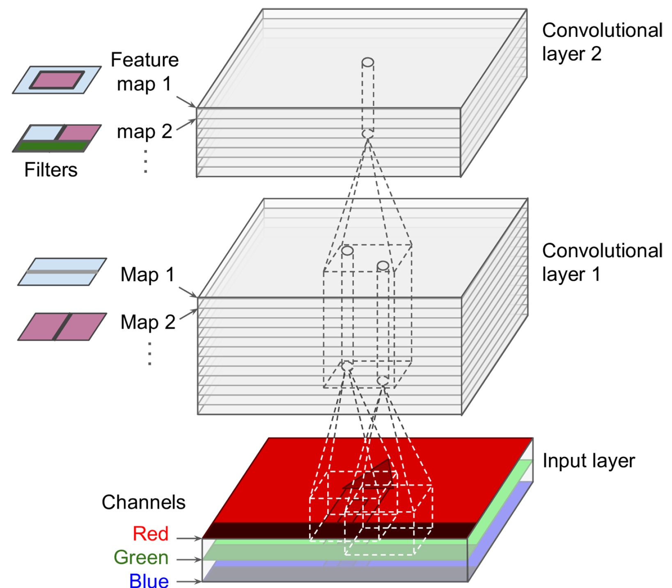
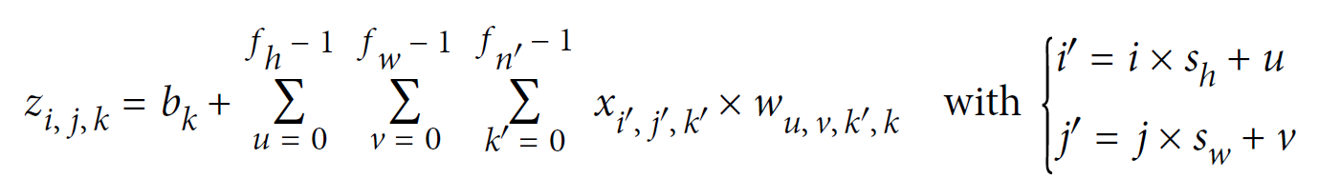
Two-dimensional Convolution with Multiple Features
Output
Input
Weights
Stride
Sum over height
Sum over width
Sum over features

Slide 36
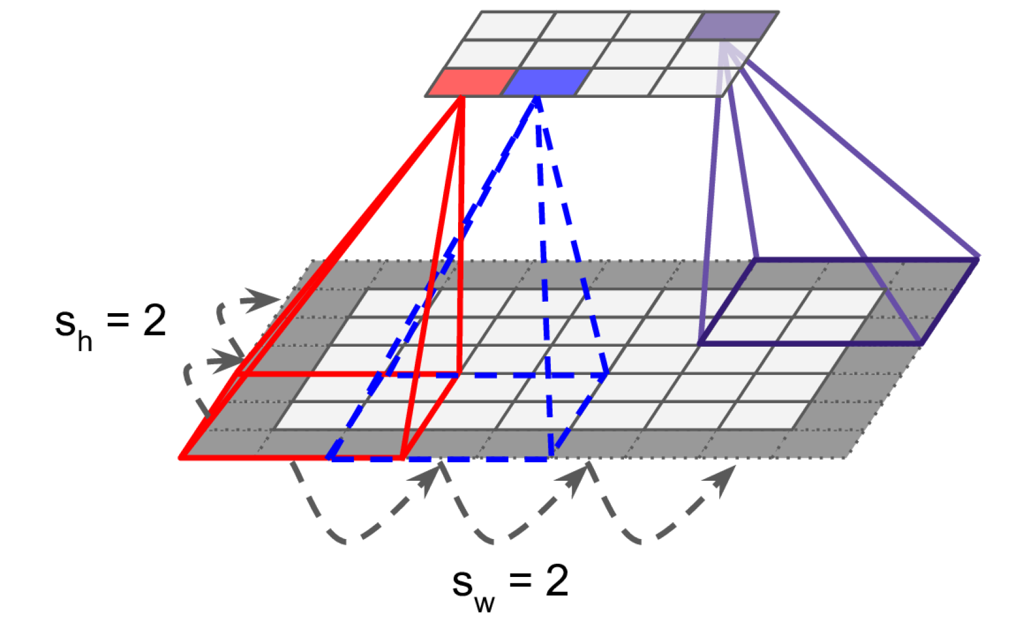
Reducing dimensionality using strides
Stride = “How much you move the filter by in each direction”
Stride is one of the features used in defining the movement of the filter layer, which defines the amount of movement of the filter on the image. Each movement of the filter on the input image will produce one value, contributing to the output image. Now, if the stride is large, it means that the filter takes a big step at each step and, therefore, will produce fewer values and a smaller output compared with the original input.

Slide 37

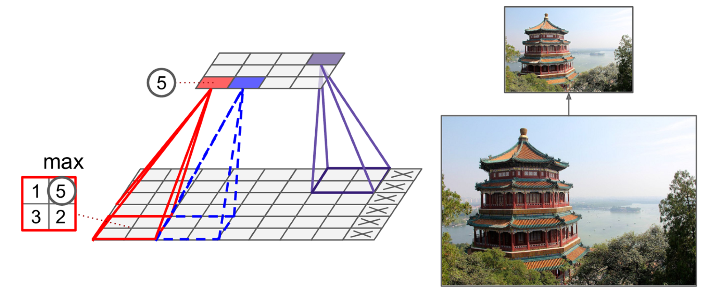
Shrinking the Input Image using Pooling Layers
Alternative: Mean/Average pooling
Notes:
Explain Difference between pooling and convolutional layer

Slide 38
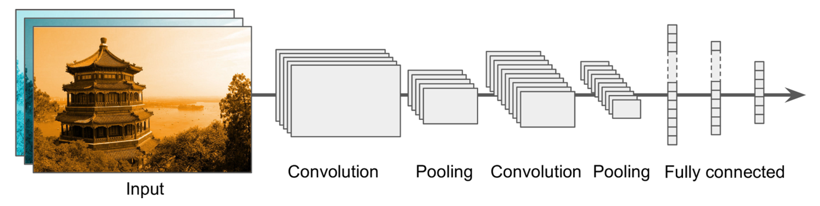

Building a Convolutional Neural Network
Prepare and load image dataset
Not enough data!

Slide 39
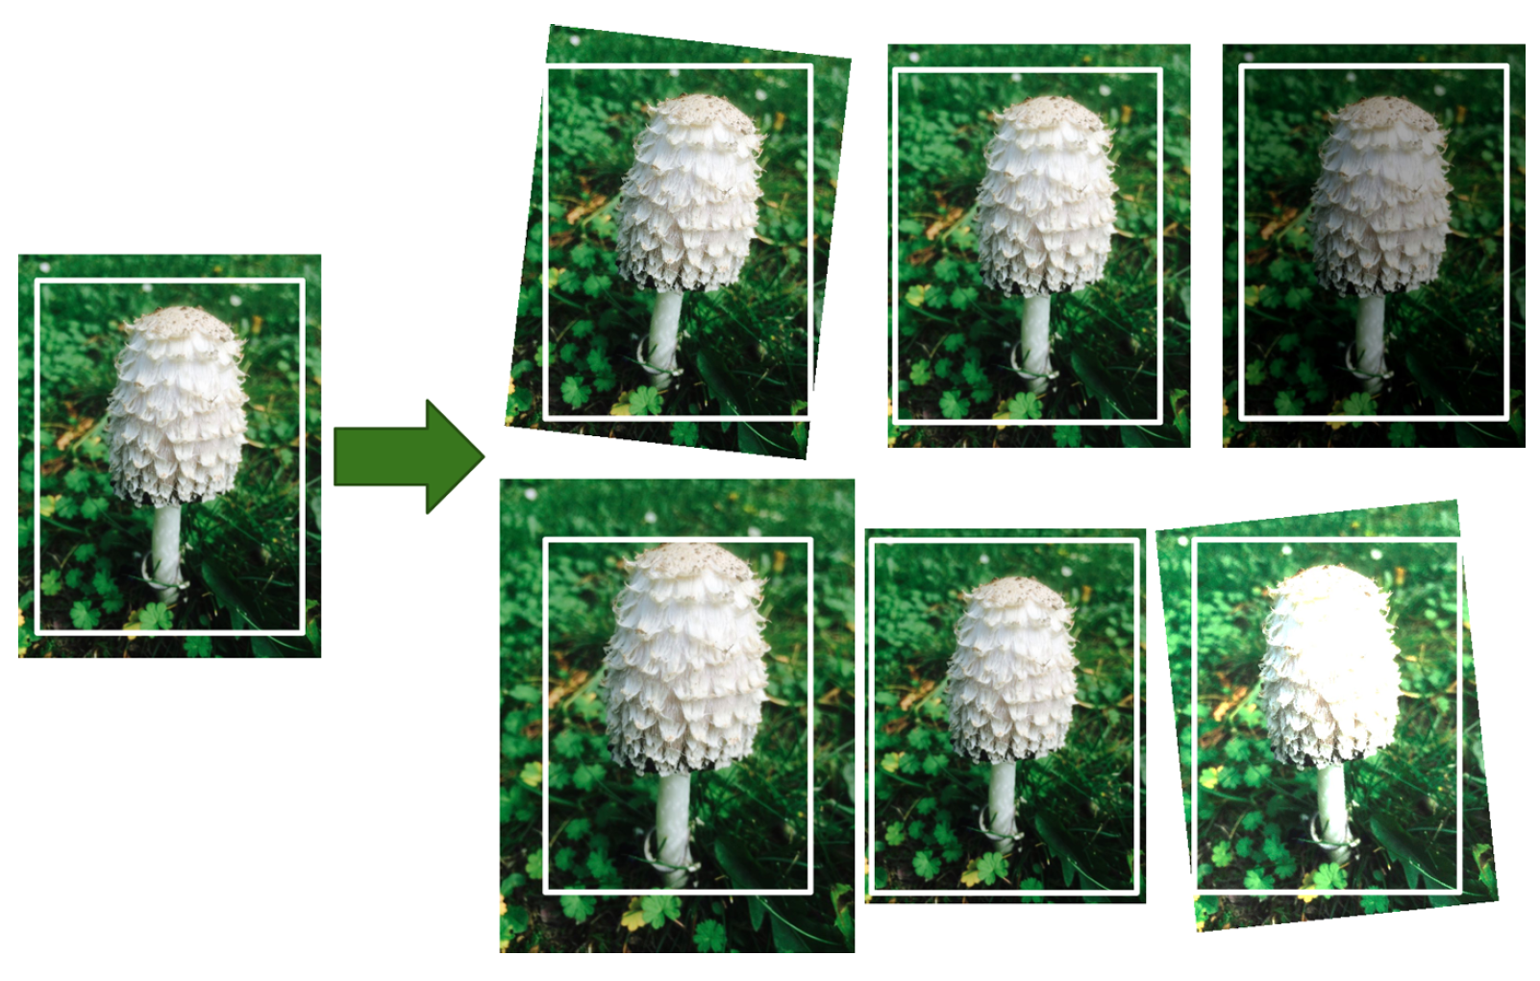
Data Augmentation = Generate realistic variances of each training instance (rotation, translation, resizing…)
Bonus: Regularizes the model

Slide 40
Building a Convolutional Neural Network
Prepare and load image dataset
First Convolution Operation
Image shrinks

Slide 41
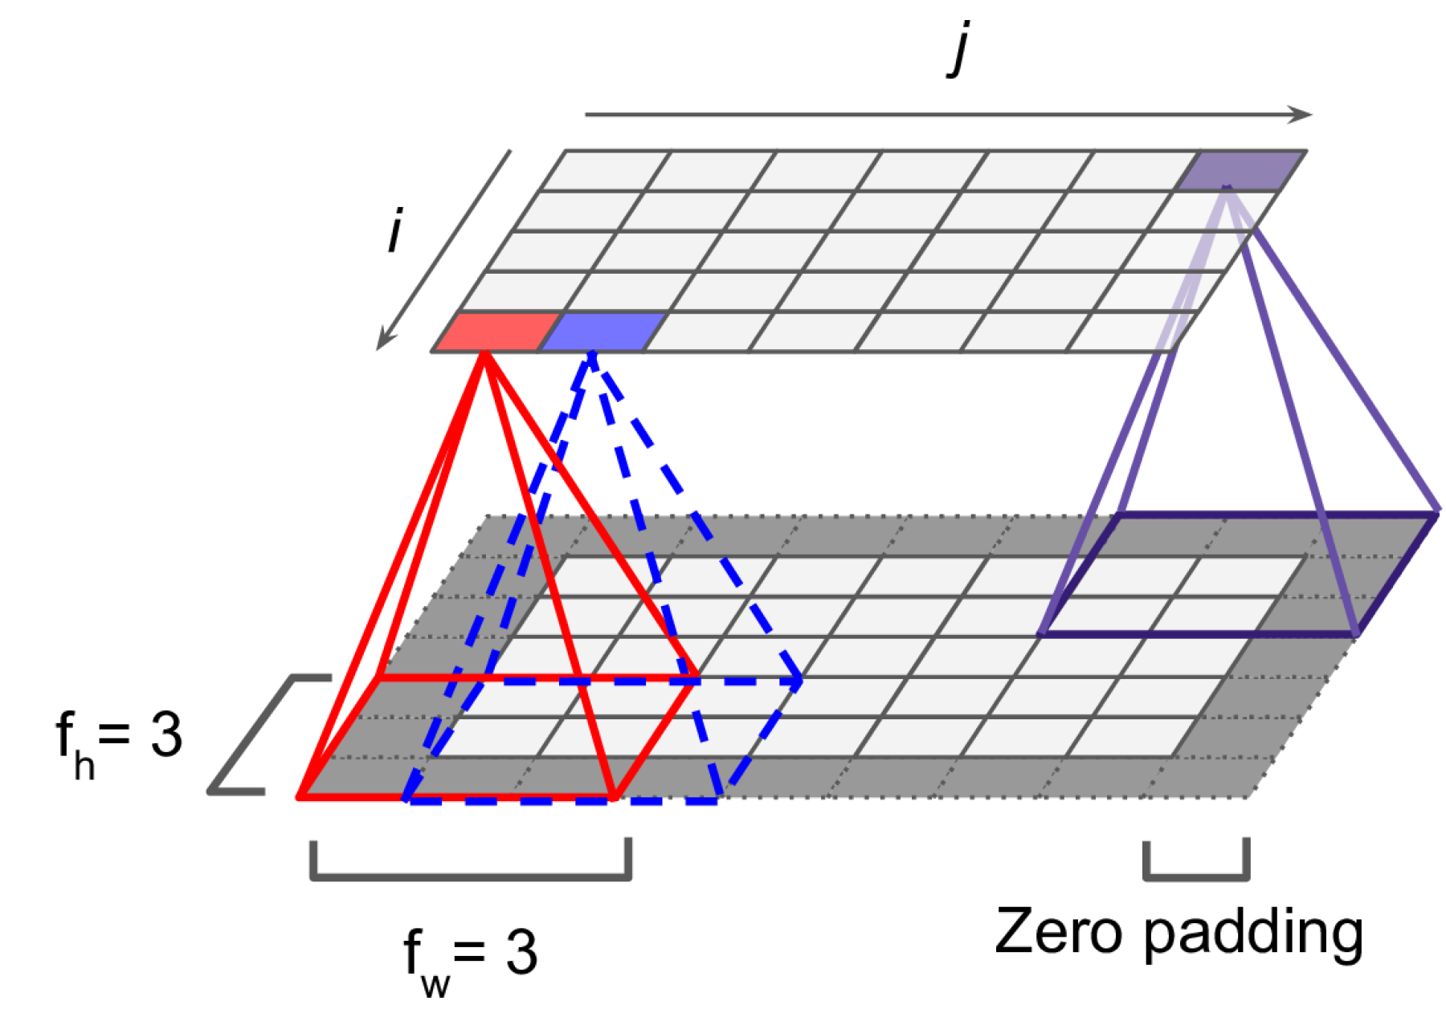
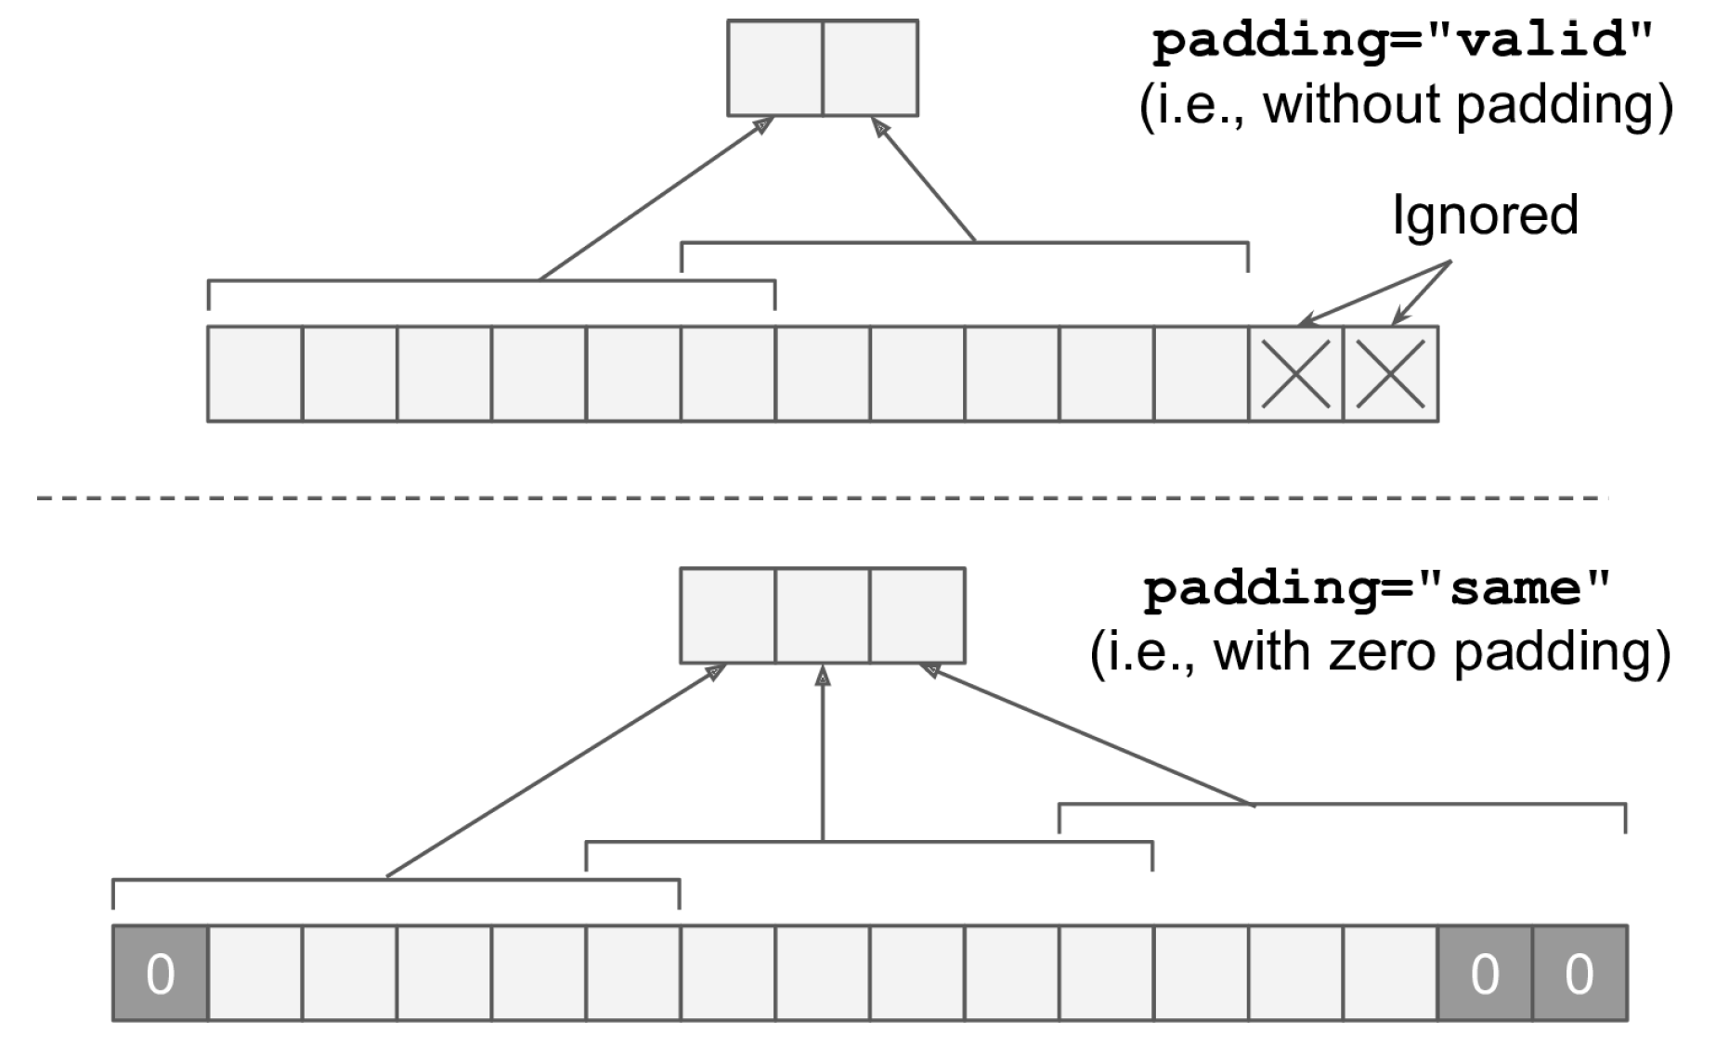
(Zero) padding to preserve the dimension of the input

Slide 42
Building a Convolutional Neural Network
Prepare and load image dataset
First Convolution Operation
Series of convolution+pooling
Dense layers

Slide 43
Train using appropriate loss (↓RAM use: ↓batch size, ↓layers, ↑strides, etc.)
Prepare and load image dataset
First Convolution Operation
Series of convolution+pooling
Dense layers

Slide 44

Building a Convolutional Neural Network
Prepare and load image dataset
Still not enough data!

Slide 45

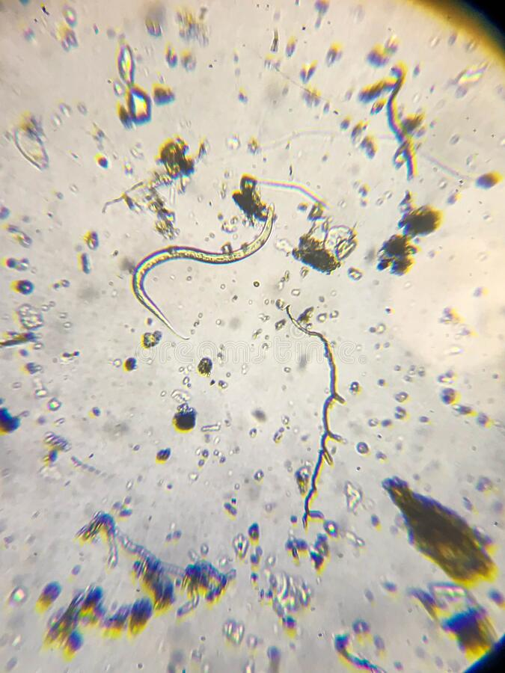
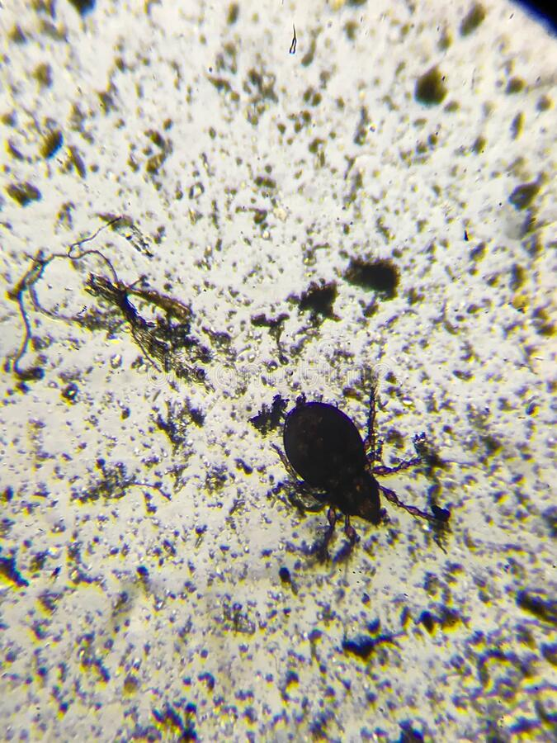
Transfer Learning = Reusing trained model for a different problem
?
↔
Source: ImageNet, Dreamstime.com
Notes:
VOTE: Who thinks it’s a good idea? Ask people who think it’s a good idea why?

Slide 46
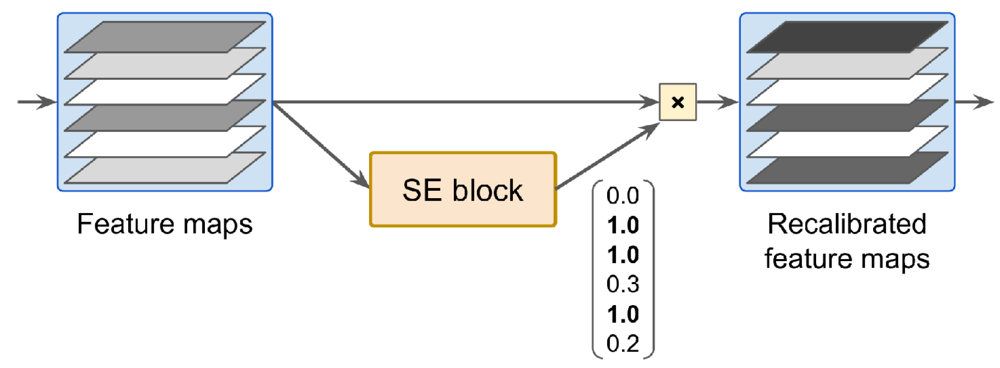
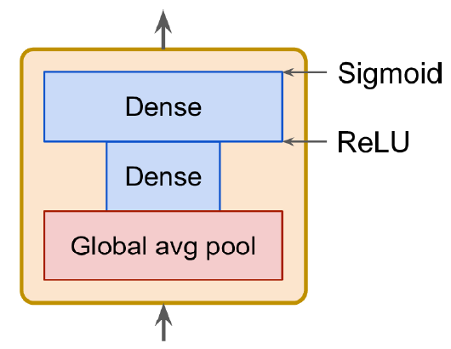
Which model to choose?
See Géron Ch14 for list of high-performance models:
AlexNet (Stacked convolutions + local response normalization)
SENet (Adds small neural networks to recalibrate feature maps)
Fully-convolutional architectures (process images of various sizes)

Slide 47


Fully-Convolutional Network = No dense layers Can process image of any size for semantic segmentation
Source: Long et al. (2015)

Slide 48


U-Net: Initially developed for biomedical image segmentation. Retains localization information
Source: Ronneberger et al. (2015)

Slide 49
Transfer Learning = Reusing trained model for a different problem
Pick a model to reuse
Load the trained weights corresponding to a similar dataset
Retrain parts of the model - Freeze existing layers & add dense layers to train - Retrain the first layers of model (closest to the image, most specialized)

Slide 50
Min 105-120: Moodle Quiz Review (5 questions, 15 min)
Learning Objectives (Géron Ch10 & Ch11):
Define an artificial neural network
Understand activation functions
Understand the steps & best practices to build an artificial neural network
Know the main hyperparameters defining a neural network’s architecture
Know the main hyperparameters controlling the training of an NN
Notes:
Questions?
Not graded

Slide 51
Legacy slides

Slide 52
Min 45-60: Moodle Quiz (5 questions, 15 min)
Learning Objectives (Géron Ch14):
Define a convolutional neural network
Discuss the main applications of convolutional neural networks
Know the steps to design and train a convolutional neural network
Define transfer learning and understand how to re-use pre-trained models
Notes:
Questions?
Not graded

Slide 53
Questions
could you explain figure 3? (didn't understand the variables)
I didn't really understand the difference with using a "bottom-up" or "top-down" strategy in CBRAIN.
"I did not understand what can be the advantages of not putting latitude and longitude information on the input vector.It is possible to summarize the article with simple terms.Thank you"
I have not found the Figs. S2a and S2b nor Tab. S1 mentioned in §4.1. I assume they are compiled in a supplement. Can you show us these figures? It would be interesting to visualise the differences in sensitivity to model architecture.
I think it could be useful to describe the next week's paper in class the week prior. As a geography student, while I understand that they built a machine learning model, I am not sure I know what it tries to predict, what is the data and even what is "moist convection in coarse scale climate model."

Slide 54
Min 75-105: Remote Sensing Image Classification using CNNs (Optional Reading 3)
Learning Objectives (Géron Ch14):
Define a convolutional neural network
Discuss the main applications of convolutional neural networks
Know the steps to design and train a convolutional neural network
Define transfer learning and understand how to re-use pre-trained models
Additional Learning Objective: 6. Define a benchmark dataset & 7. Address class imbalance

Slide 55

Min 75-85: Re-read the article and write down (1) the scientific goal of the paper; (2) One simple question with your neighbor.
Example: Can you remind us what accuracy is?

Slide 56

Min 75-85: Deep Learning to Emulate the Components of Earth System Models
Re-read the article and write down (1) the scientific goal of the paper; (2) One simple question with your neighbor. Example: How did the authors choose their best neural network architecture?

Slide 57
Which models work best to classify land cover from multi-sensor satellite imagery?
Problem: - Assigning labels to a given scene (scene classification) is technical
- Different models developed on different datasets→no objective comparison
Idea: Create a benchmark dataset to objectively compare different models
Results: Benchmark dataset + Comparison of ResNet & DenseNet

Slide 58




What is a benchmark dataset?
(Open) dataset used to objectively compare (ML) models for the same task

Slide 59



The authors proposed the SEN12MS Dataset
Open dataset used to objectively compare (ML) models for land-cover classification from multi-sensor, multi-spectral remote imagery
Sentinel:
Synthetic Aperture Radar image with 2 polarimetric channels
Sentinel-2 optical images with 13 multi-spectral channels
MODIS global land cover
Source: ESA, Cervest

Slide 60


Compared the performance of ResNet vs DenseNet
Source: Géron Ch14, He et al. (2015), Huang et al. (2018)

Slide 61


Compared the performance of ResNet vs DenseNet

Slide 62

Neural Networks sometimes detect finer information than human-derived labels!

Slide 63



Slide 64
Mitigating Class Imbalance
Random oversampling = Randomly sampling more from minority class
Random undersampling = Sampling less from majority class
Collecting more data
Changing your loss function and/or performance metric
Generate synthetic data

Slide 65
Min 105-120: Review Moodle Quiz
Learning Objectives (Géron Ch14):
Define a convolutional neural network
Discuss the main applications of convolutional neural networks
Know the steps to design and train a convolutional neural network
Define transfer learning and understand how to re-use pre-trained models
Notes:
Questions?
Not graded

